Slide 1
Easy as CAB
SER 2016 Div 2
(and Kattis)

Slide 2
Problem Statement
https://open.kattis.com/problems/easyascab
Given a “dictionary”, formulate the alphabet

Slide 3
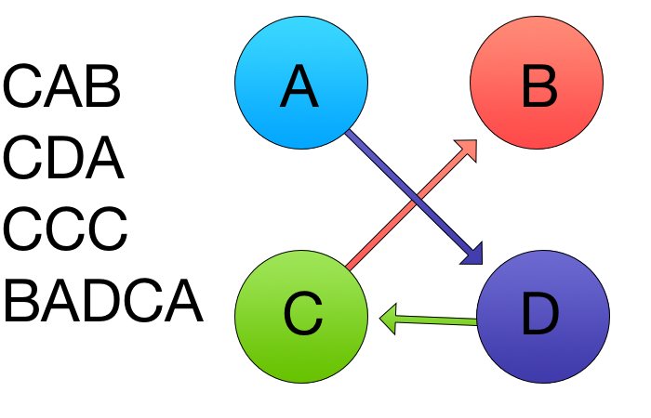
Example 1
Graph behaves like a linked list - no redundancy

Slide 4
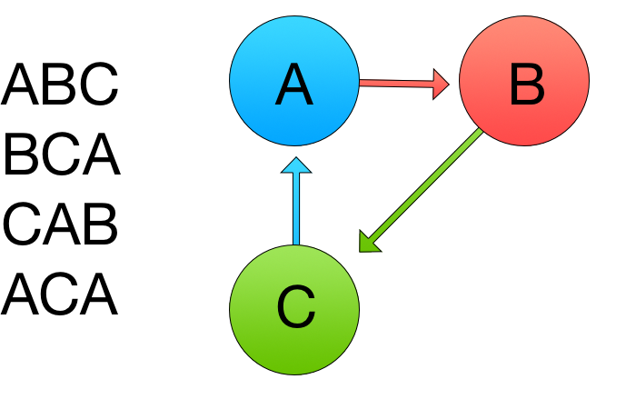
Example 2
Impossible to derive an alphabet - alphabets have a beginning and an end

Slide 5
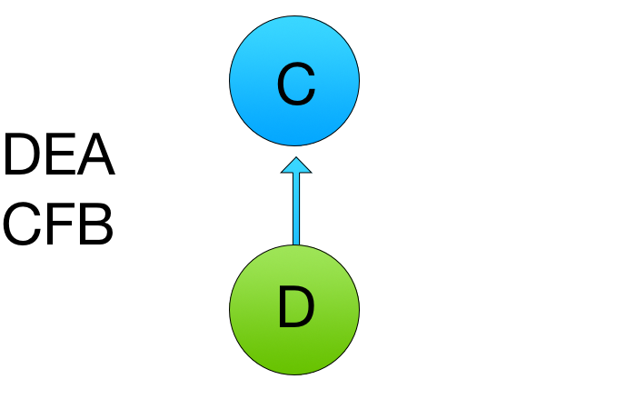
Example 2
More that one alphabet can be produced

Slide 6
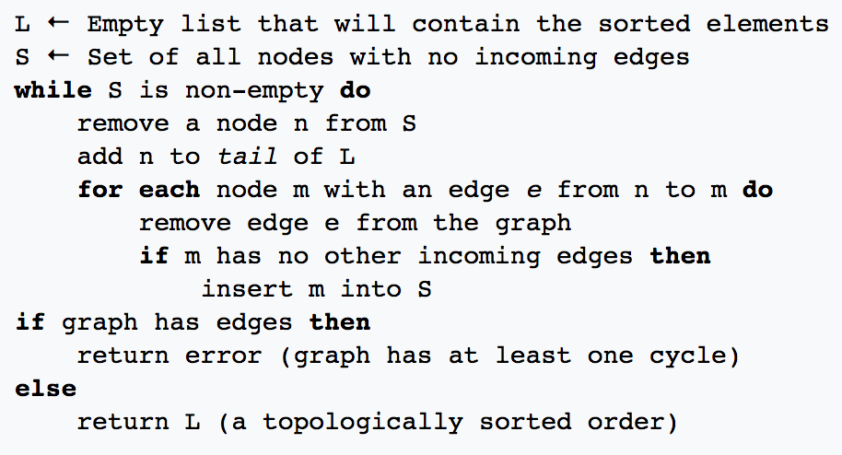
Topological Sort
Given a Directed, Acyclic Graph, produce a sorted list of the elements of that graph
Directed edges represent individual comparisons

Slide 7
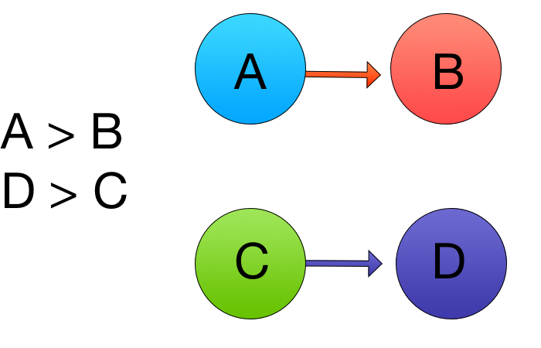
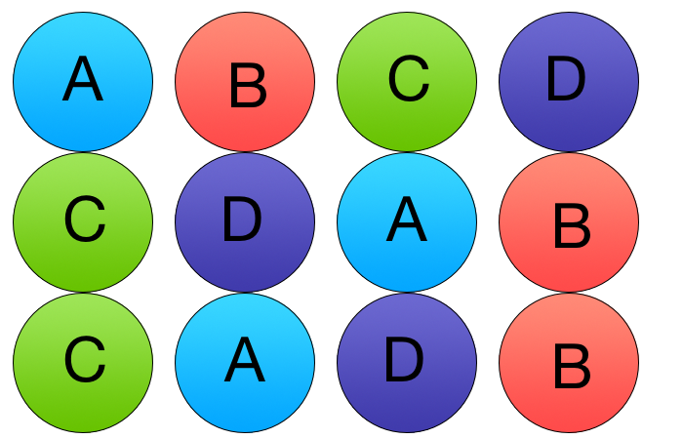
Topological Sort
Topological sort…
Requires an acyclic graph
Produces one of >1 possible orderings

Slide 8
Application
We need to apply topological sort to our set of comparisons, but also check for ambiguity, contradiction
When is a graph ambiguous or contradictory?

Slide 9
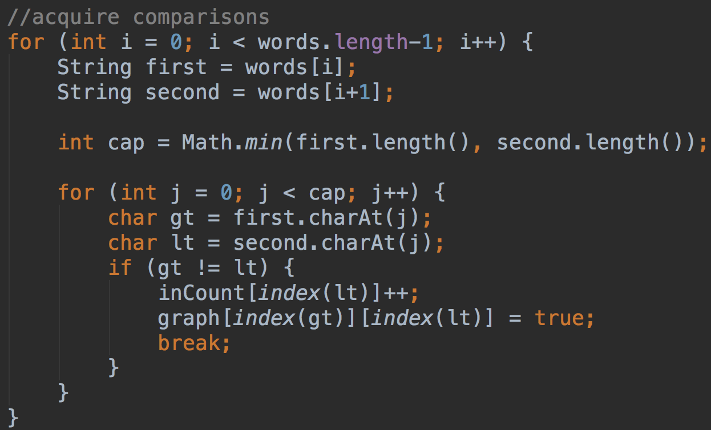
Code: Build Graph

Slide 10
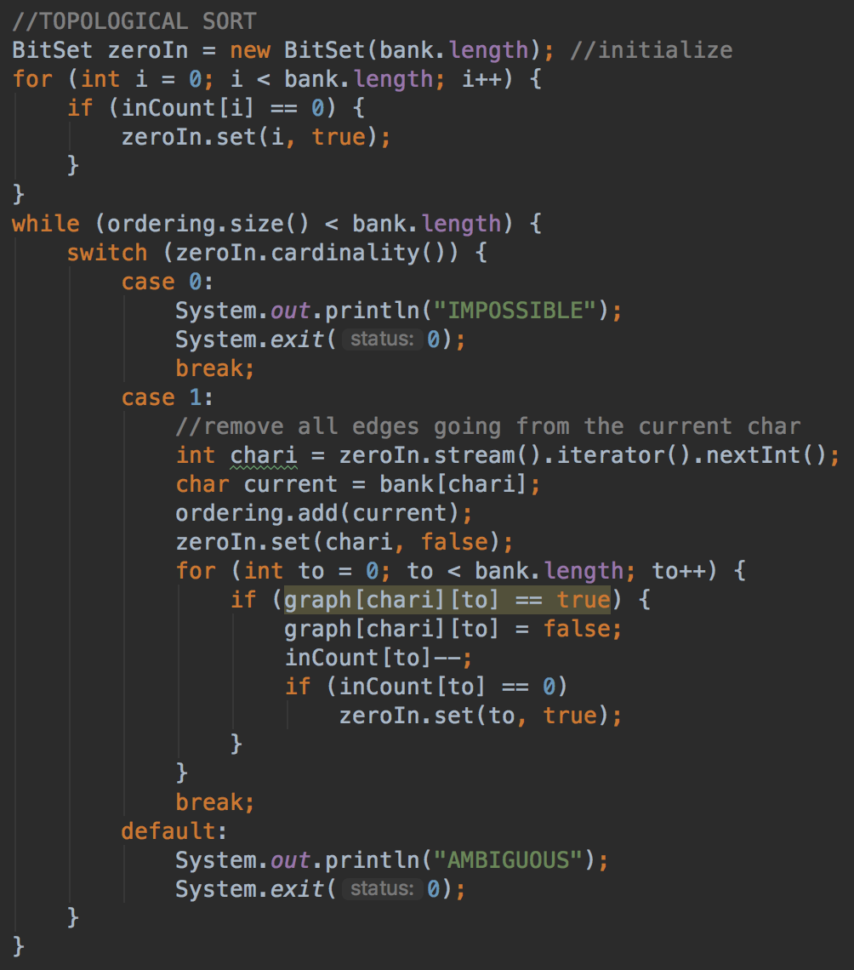
Code: Topological
Sort

